Slide 1
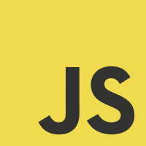
JavaScript
Fundamentals

Slide 2
Week Summary
Day 1 | Core: History, Data Types, DOM, Variables, Functions, Arrays
Day 2 | Core ; Mini Projects, Design
Day 3 | Objects
Day 4 | Objects, JSON, AJAX
Day 5 | Problem Day

Slide 3
JavaScript
Language Core

Slide 4
Core
Language basics
Console applications
Variables, constants, data types
Selection structures – if-else, switch
Iteration structures (loops) – while, do-while, for, for each, recursion
Data structures – arrays, Objects
Methods
Error handling
Algorithms

Slide 5
Objectives
Candidates should be able to
write simple applications in JavaScript
write a program that uses an if-else statement
write a program that uses a loop
write a program that uses an array
explain what an algorithm is and give an example

Slide 6
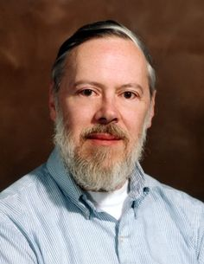
Coding good practises
Code – lots!
“The only way to learn a new programming language
is by writing programs in it.” - Dennis Ritchie, creator of C and Unix
Read important material at least twice
Coding concepts are complex and most people don’t understand them the first time
Collect working examples of code related to key concepts
Play with the code and try out ways you might use it
Don’t try to code all night
Working on screens at night disrupts sleep
Evidence at: https://justgetflux.com/news/2014/12/21/advice.html
Ask for help if you need it
Tutors will help whenever you need them
Excellent programming support websites include: StackOverflow, Code Project
Tutorial and reference websites include: Microsoft Developer Network
Have faith in yourself!
Everyone struggles with coding at first, but practice and persistence lead to progress

Slide 7
What do you already know about JavaScript?

Slide 8

Background, history and development
JavaScript was invented by Brendan Eich in 1995 (in 10 days!)
and became an ECMA standard in 1997.
ECMA-262 is the official name.
ECMAScript 9 (released in 2018) is the latest official version of JavaScript and is Object Orientated.
More about JS versions:
https://www.w3schools.com/js/js_versions.asp
https://en.wikipedia.org/wiki/Brendan_Eich

Slide 9
JavaScript is a programming language
JavaScript is object-based, JavaScript EM6 is object orientated
JavaScript is event-driven
JavaScript is platform-independent
JavaScript is a Front End language
JavaScript is a loosely typed programming language
JavaScript is an interpreted language

Slide 10
What is JavaScript?
JavaScript is the programming language of HTML, CSS and the Web.
JavaScript is parsed on the client
JavaScript is an interpreted programming language
JavaScript is the most popular programming language in the world.
JavaScript and Java are completely different languages, both in concept and design.
JavaScript is one of the 3 languages all web developers should learn:
1. HTML to define the content of web pages
2. CSS to specify the layout of web pages
3. JavaScript to program the behaviour of web pages

Slide 11
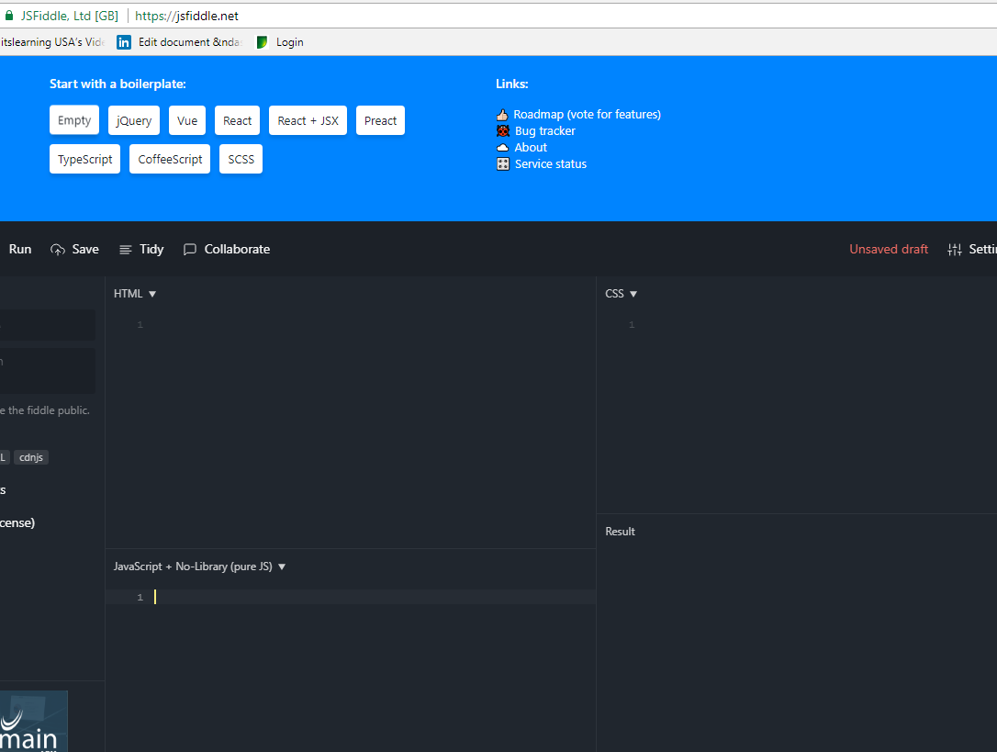
Tools and Resources
Plunker
http://plnkr.co/
Brackets
http://brackets.io/
also install Beautify
How to use Brackets
https://github.com/adobe/brackets/wiki/How-to-Use-Brackets
http://www.w3schools.com/js/default.asp
https://jsfiddle.net/

Slide 12
Tips when learning JavaScript
Don't Use Short-Hand and Always, Always Use Semicolons!
Technically, you can get away with omitting most curly braces and semi-colons but it can lead to lots of unexpected errors.
Comment Your Code
Get in the habit to comment your code – it also helps you understand what you have done when you return to it at a later date. Use // to comment, you don’t need to close a JavaScript comment.
Test small piece of code to check it works as expected
console.log(); window.alert(); Test Test Test
Use the right tool for the job
"A common error in JavaScript programs is to use an object when an array is required or an array when an object is required. The rule is simple: when the property names are small sequential integers, you should use an array. Otherwise, use an object.

Slide 13
Use techniques and code that reduce errors
There are many ways of solving the same problem in JavaScript. Using techniques and code that reduce your error rate. Learn to learn the good JavaScript and avoid the bad JavaScript. eg. == and ===
Place scripts at the bottom of the webpage for better performance
The primary goal is to make the webpage load as quickly as possible for the user. When loading a script, the browser can't continue on until the entire file has been loaded. Thus, the user will have to wait longer before noticing any progress.
If you have JS files whose only purpose is to add functionality -- for example, after a button is clicked -- go ahead and place those files at the bottom, just before the closing body tag. This is absolutely a best practice.
There will be bugs
Reduce your error rate by coding well. Learn and use features of the language that reduce error rate.
Bad parts of JavaScript are not useless – they are dangerous!
Separate JavaScript from HTML and CSS
It is good practice to separate content structure (HTML), presentation (CSS) and behaviours (JavaScript). Keeping separation produces code that is easier to maintain and reuse.
Spend time on Design
It is well worth spending time designing your solutions before implementation as your JavaScript logic increases

Slide 14
HTML DOM

Slide 15
HTML DOM
What is the HTML DOM?
The HTML DOM is a standard object model and programming interface for HTML.
It defines:
The HTML elements as objects
The properties of all HTML elements
The methods to access all HTML elements
The events for all HTML elements
In other words:
The HTML DOM is a standard for how to get, change, add, or delete HTML elements.

Slide 16
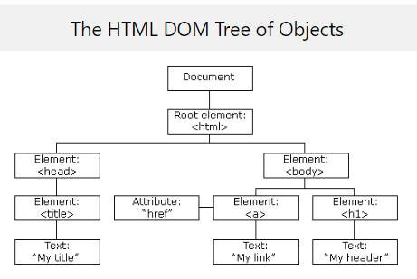
When a web page is loaded, the browser creates a Document Object Model of the page.
The HTML Document Object Model (DOM) is the browser's view of an HTML page as an object hierarchy, starting with the browser window itself and moving deeper into the page, including all of the elements on the page and their attributes..
The HTML DOM model is constructed as a tree of Objects.
The top-level object is window. The document object is a child of window and all the objects (i.e, elements or nodes) that appear on the page (e.g, forms, links, images, tables, etc.) are descendants of the document object. These objects can have children of their own. For example, form objects generally have several child objects, including textboxes, radio buttons, and select menus.

Slide 17
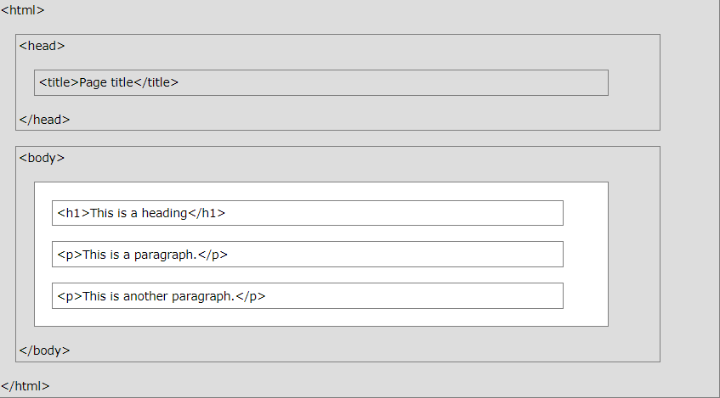
The Basic HTML Page
<!DOCTYPE html> <html> <head> <title>Page Title</title> </head> <body> <h1>My First Heading</h1> <p>My first paragraph.</p> <p>This is another paragraph.</p> </body> </html>
The <!DOCTYPE html> declaration defines this document to be HTML5
The <html> element is the root element of an HTML page
The <head> element contains meta information about the document
The <title> element specifies a title for the document
The <body> element contains the visible page content
The <h1> element defines a large heading
The <p> element defines a paragraph

Slide 18
Console statements
Alert(“Hello”) or alert(‘Hello’)
Clear() ….. To clear the screen
console.log(document.domain);
console.log(document.URL);
console.log(document.title);
//To change the existing title, you can as DOM is not read only.
document.title = 'Welcome to DPP';
//It will display all the elements of the document in an array
console.log(document.all);
//Get Eleement by ID
console.log(document.getElementById('header'));

Slide 19
Difference between innerText and textConent
In index.html
<h1 class="page-header" id="header"> My website <span style="display:none"> Extra text</span></h1>
In dom.js, run the following code to see the difference
//Difference between textContent and innerText
var pageheader = document.getElementById('header');
//see the following result in console
console.log(pageheader.textContent);
console.log(pageheader.innerText);
textContent will show all the contents including display:none, while innerText will only show the text that suppose to be visible.

Slide 20

InnerHtml
var pageheader = document.getElementById('header');
//replacing the current h1 with h3 tag, using innerHTML
pageheader.innerHTML = '<h3> New H3 header </h3>’;
The HTML inspector output
pageheader.style.borderBottom = 'solid 2px green';

Slide 21
HTML Events
HTML Events are "things" that happen to HTML elements.
Event Handlers are attributes that force an element to “listen” for a specific event to occur
Event handlers all begin with the letters "on"
When JavaScript is used in HTML pages, JavaScript can "react" on these events.
An HTML event can be something the browser does, or something a user does.
Here are some examples of HTML events:
An HTML web page has finished loading
An HTML input field is changed
An HTML button is clicked
Often, when events happen, you may want to do something.
JavaScript lets you execute code when events are detected.
Here is a list of some common HTML events:

Slide 22
Event | Description
onchange | An HTML element has been changed
onclick | The user clicks an HTML element
onmouseover | The user moves the mouse over an HTML element
onmouseout | The user moves the mouse away from an HTML element
onkeydown | The user pushes a keyboard key
onload | The browser has finished loading the page
Using JavaScript Event listeners are considered the best technique to use in modern code.
Event listeners keep the JavaScript cleanly separate from the HTML

Slide 23
User Events and JavaScript Event Handlers
DOM objects
button
reset
submit
radio
checkbox
link
form
text
textarea
select
image
area
window
User Events
abort
blur
click
change
error
focus
load
mouseOver
mouseOut
reset
select
Submit
unLoad
Event Handlers
onabort
onblur
onclick
onchange
onerror
onfocus
onload
onmouseover
onmouseout
onreset
onselect
onsubmit
onunload

Slide 24
Example of Event
<h1> JavaScript programming </h1>
<div> <button onclick="clickf()"> Click here </button> </div>
<script type="text/JavaScript">
function clickf()
{
alert("you clicked the button");
}
</script>

Slide 25

Language Basics

Slide 26
Data Types

Slide 27
var cars = ["Saab", "Volvo", "BMW"];

Slide 28
Mutable is a type of variable that can be changed.
In JavaScript, only objects and arrays are mutable, not primitive values.
A mutable object is an object whose state can be modified after it is created.
Immutables are the objects whose state cannot be changed once the object is created.
(You can make a variable name point to a new value, but the previous value is still held in memory.
Hence the need for garbage collection.)

Slide 29
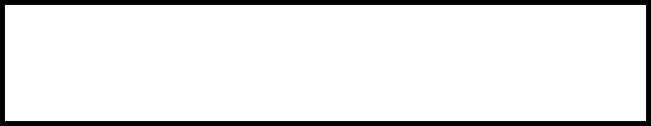
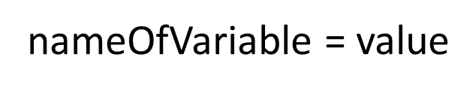
Variables
<!DOCTYPE html>
<html>
<body>
<h2>JavaScript Variables</h2>
<p>Strings are written with quotes.</p>
<p>Numbers are written without quotes.</p>
<p id="demo"></p>
<script>
var age =33;
var fname = "John";
var lname = ‘Smith!';
document.getElementById("demo").innerHTML =
fname + "<br>" + lname + "<br>" + age;
</script>
</body>
</html>
Variables are dynamic in JavaScript
A dynamic variable is a variable whose address is determined when the program runs.
In contrast, a static variable has memory reserved for it at compilation time.
All JavaScript variables must be identified with unique names.
These unique names are called identifiers.
The undefined property indicates that a variable has not been assigned a value, or not declared at all.

Slide 30


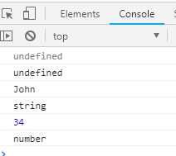
<!DOCTYPE html>
<html>
<head></head>
<body>
<h2>JavaScript</h2>
<script>
var x; // Now x is undefined x = 5;
console.log(x);
console.log(typeof(x));
x = "John"; // Now x is a String
console.log(x);
console.log(typeof(x));
var x = 34.00; // Written with decimals var x2 = 34; // Written without decimals
console.log(x);
console.log(typeof(x));
</script>
</body>
</html>
console.log
typeof()
undefined
string primitive
number primitive
F12

Slide 31

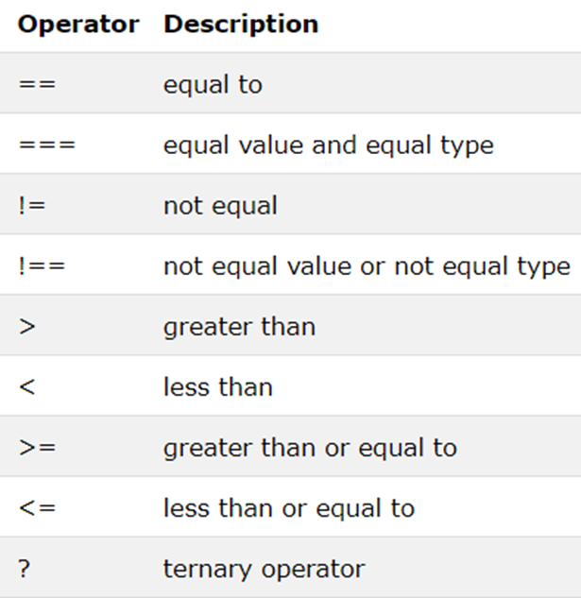
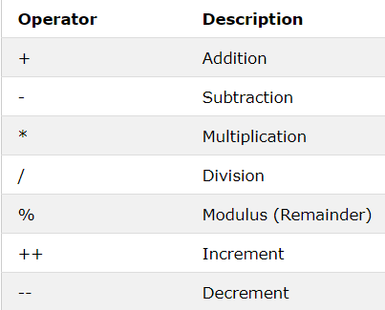
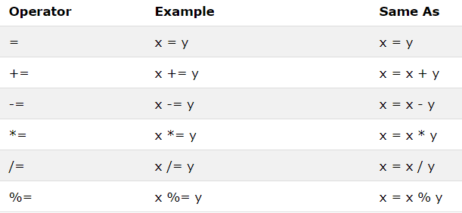
Operators
Arithmetic
Assignment
? The conditional (ternary) operator is the only JavaScript operator that takes three operands. This operator is frequently used as a shortcut for the if-else statement.
Syntax : condition ? exprT : exprF
Example:
var age = 26;
var beverage = (age >= 21) ? "Beer" : "Juice";
console.log(beverage); // "Beer"

Slide 32
Selection
Conditional statements are used to perform different actions based on different conditions.
If Else
var greeting;
var time = new Date().getHours();
if (time < 10) {
greeting = "Good morning";
} else if (time < 20) {
greeting = "Good day";
} else {
greeting = "Good evening";
}
document.getElementById("demo").innerHTML = greeting;
if (condition) {
block of code to be executed
if the condition is true
}
2 operators to test a condition
if (time > 5 && time < 10)

Slide 33


<!DOCTYPE html>
<html>
<body>
<p id="demo"></p>
<script>
window.addEventListener('load', age, false);
function age() {
var ageAsString = window.prompt("What is your age? ", "");
var age = Number(ageAsString);
alert(age);
if (age < 40) {
alert("Oh you're young...");
console.log("Oh you are so young...");
document.getElementById("demo").innerHTML = "Oh you are so young";
} else if (age === 40) {
alert("Hey, you're 40!");
console.log("Hey, you're 40!");
document.getElementById("demo").innerHTML = "Hey, you're 40!";
} else {
alert("Don't worry, you're young at heart");
console.log("Don't worry, you're young at heart");
document.getElementById("demo").innerHTML = "Don't worry, you're young at heart";
}
}
</script>
</body>
</html>
If Else
selection If else
event listener
function
operator ===
document.getElementByID
alert
end of statements ;
What is interpreted on page load
Position of script on web page

Slide 34
Task: Capital and country
Ask user to enter a capital name (prompt)
Store it in a variable and convert it into lower case
Use if-else statement to find the country for the given capital.

Slide 35
Selection: Switch statement
The switch statement is used to perform different actions based on given conditions/cases.
Use the switch statement to select one of many code blocks to be executed.
When JavaScript reaches a break keyword, it breaks out of the switch block.
It is not necessary to break the last case in a switch block. The block breaks (ends) there anyway.
The default keyword specifies the code to run if there is no case match:
Switch
switch(expression) {
case x:
code block
break;
case y:
code block
break;
default:
code block
}

Slide 36


<!DOCTYPE html>
<html>
<body>
<p id="demo"></p>
<script>
var day;
switch (new Date().getDay()) {
case 0:
day = "Sunday";
break;
case 1:
day = "Monday";
break;
case 2:
day = "Tuesday";
break;
case 3:
day = "Wednesday";
break;
case 4:
day = "Thursday";
break;
case 5:
day = "Friday";
break;
case 6:
day = "Saturday";
}
document.getElementById("demo").innerHTML = "Today is " + day;
</script>
</body>
</html>
Switch
Selection
Switch
break - is this good programming?
Date()
DOM write

Slide 37
Project: Dice game
Randomly generate 6 numbers using Math.random()
Round the number to 6 using Math.round() or Math.ceil() as number generated is in fractions.
Create 6 switch statement cases based on the above 6 numbers (1 to 6).
Call the switch based on the random number generated.
You will need 6 images in the images folder (1.jpg…….)
When a specific number is called in case, call the corresponding image from the images folder (e.g. 4.jpg for case 4)

Slide 38
Iteration
Iteration/Loop logic can execute a block of code a number of times.
For
var i;
for (i = 0; i < cars.length; i++) {
text += cars[i] + "<br>";
}
for (statement 1; statement 2; statement 3) {
code block to be executed
}
Do
While
do {
text += "The number is " + i;
i++;
}
while (i < 10);
do {
code block to be executed
}
while (condition);
While
Do
while (i < 10) {
text += "The number is " + i;
i++;
}
while (condition) {
code block to be executed
}

Slide 39
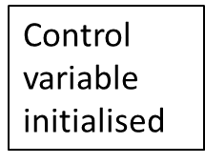
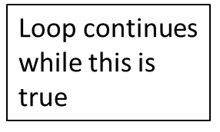
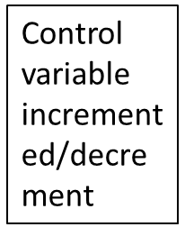
For loops are commonly used to do some work to the elements in an array
Var numbers =[ 1, 2, 3, 4];
Length of array used to control for loop
for (int i = 0; i < numbers.length; i++)
{
total += numbers[i];
}
Loop control variable used as array index – makes the loop work through the array
Concatentation operator often useful for calculating totals.
This line means the same as: total = total + numbers[i];

Slide 40
Iteration - while
int numberOfTimes = 0;
while (numberOfTimes < 10)
{
Console.WriteLine(" numberOfTimes is : " + numberOfTimes );
numberOfTimes ++;
}
When you want a piece of code to run 0 or more times
Stop condition is at the top
When it’s met, the loop stops running
If it’s met before the loop has been run, then the code in the loop won’t be run at all
A while loop must contain some code that will eventually meet the stop condition by changing the value of the variable in the stop condition, e.g.
Increasing a counter
Getting user input
Otherwise, you get an endless loop
Ctl+C breaks out of an endless loop in the console
bool happiness = true;
while (happiness)
{
EatSomeChocolate();
happiness = CheckIfTheresAnyChocolateLeft();
}
bool happiness = true;
while (happiness)
{
EatSomeChocolate();
moreChocolate = CheckIfTheresAnyChocolateLeft();
}

Slide 41
Practise
Variables, Selection, Iteration, Expressions

Slide 42
addEventListener() method
The addEventListener() method attaches an event handler to a specified element.
You can add many event handlers to one element.
Syntax:
element.addEventListener(event, function, useCapture);
The first parameter is the type of the event (like "click" or "mousedown").
The second parameter is the function we want to call when the event occurs.
The third parameter is a Boolean value specifying whether to use event bubbling or event capturing. This parameter is optional.
With bubbling, the event is first captured and handled by the innermost element and then propagated to outer elements.
With capturing, the event is first captured by the outermost element and propagated to the inner elements.

Slide 43
<!DOCTYPE html>
<html>
<head>
<script>
window.alert("Hello World");
alert(“Hello World”);
</script>
</head>
<body onload="myfirst()"> BAD PRACTICE inline JavaScript
<p id="demo">message</p>
<script>
window.alert("Hello World");
alert(“Hello World”);
</script>
</body>
</html>
1

Slide 44
2
<!DOCTYPE html>
<html>
<head>
</head>
<body>
<span id="demo"></span>
<script>
window.addEventListener('load',myfirst,false);
function myfirst(){
window.alert("Hello World");
document.getElementById("demo").innerHTML = "Hello World";
}
</script>
</body>
</html>
3 parameters of addEventListener
https://www.w3schools.com/jsref/met_document_addeventlistener.asp

Slide 45
<!DOCTYPE html>
<html>
<head></head>
<body>
<input type="text" id="input1"/>
<div><button id="button1">Button</button> </div>
<div id="demo">Test</div>
<script>
//EVENT LISTENER
var event1 = document.getElementById("button1");
event1.addEventListener('click',myfirst,false);
function myfirst(){
//User input 1
var userinput1 = document.getElementById("input1").value;
//Output 1
document.getElementById("demo").innerHTML = userinput1;
}
</script>
</body>
</html>
3

Slide 46
<!DOCTYPE html>
<html>
<head></head>
<body>
<p>Please enter 2 numbers below</p>
<input type="number" id="input1"/>
<input type="number" id="input2"/>
<div><button id="button1">Sum of the two numbers</button> </div>
<div id="demo"></div>
<script>
//EVENT LISTENER
var event1 = document.getElementById("button1");
event1.addEventListener('click',myfirst,false);
function myfirst(){
//User input 1 convert in JS to a number
var userinput1 = parseInt(document.getElementById("input1").value);
//alert(userinput1);
//User input 2 convert in JS to a number
var userinput2 = parseInt(document.getElementById("input2").value);
//alert(userinput2);
//Output 1
document.getElementById("demo").innerHTML = userinput1 + userinput2;
}
</script>
</body>
</html>
4
Task:
Based on this program, make a small calculator which Add, Subtract, Multiply and Divide given inputs.

Slide 47
<!DOCTYPE html>
<html>
<head></head>
<body>
<p>Please enter 2 numbers below</p>
<form>
<input type="number" id="input1"/>
<input type="number" id="input2"/>
</form>
<div><button id="button1">Sum of the two numbers</button> </div>
<div id="demo"></div>
<script>
//EVENT LISTENER
var event1 = document.getElementById("button1");
event1.addEventListener('click',myfirst,false);
function myfirst(){
//User input 1 convert in JS to a number
var userinput1 = parseInt(document.getElementById("input1").value);
//alert(userinput1);
//User input 2 convert in JS to a number
var userinput2 = parseInt(document.getElementById("input2").value);
//alert(userinput2);
if (userinput1 > userinput2){
//Output 1
document.getElementById("demo").innerHTML = userinput1;
} else {
//Output 2
document.getElementById("demo").innerHTML = userinput2;
}
}
</script>
</body>
</html>
5

Slide 48
<!DOCTYPE html>
<html>
<head></head>
<body>
<p>Please enter 2 numbers below</p>
<input type="number" id="input1"/>
<input type="number" id="input2"/>
<div><button id="button1">Sum of the two numbers</button> </div>
<div id="demo"></div>
<script>
//EVENT LISTENER
var event1 = document.getElementById("button1");
event1.addEventListener('click',myfirst,false);
function myfirst(){
//User input 1 convert in JS to a number
var userinput1 = parseInt(document.getElementById("input1").value);
//alert(userinput1);
//User input 2 convert in JS to a number
var userinput2 = parseInt(document.getElementById("input2").value);
//alert(userinput2);
if (userinput1 === userinput2){
//Output 1
document.getElementById("demo").innerHTML = "number is same";
} else {
//Output 2
document.getElementById("demo").innerHTML = "number is different";
}
}
</script>
</body>
</html>
6

Slide 49
<!DOCTYPE html>
<html>
<head></head>
<body>
<p>Please enter a number below</p>
<form>
<input type="number" id="input1"/>
</form>
<div><button id="button1">Sum of the two numbers</button> </div>
<div id="output1"></div>
<div id="output2"></div>
<script>
//EVENT LISTENER
var event1 = document.getElementById("button1");
event1.addEventListener('click',myfirst,false);
function myfirst(){
//User input 1 convert in JS to a number
var userinput1 = parseInt(document.getElementById("input1").value);
//alert(userinput1);
document.getElementById("output1").innerHTML = userinput1 + 1;
document.getElementById("output2").innerHTML = userinput1 -1;
}
</script>
</body>
</html>
7

Slide 50
<!DOCTYPE html>
<html>
<head></head>
<body>
<p>Please enter 2 numbers below</p>
<form>
<input type="number" id="input1"/>
<input type="number" id="input2"/>
</form>
<div><button id="button1">Number</button> </div>
<div id="demo"></div>
<script>
//EVENT LISTENER
var event1 = document.getElementById("button1");
event1.addEventListener('click',myfirst,false);
function myfirst(){
//User input 1 convert in JS to a number
var userinput1 = parseInt(document.getElementById("input1").value);
//User input 1 convert in JS to a number
var userinput2 = parseInt(document.getElementById("input2").value);
if (userinput1 > 10 && userinput2 > 10){
document.getElementById("demo").innerHTML = "both numbers are > 10";
} else if (userinput1 > 10) {
document.getElementById("demo").innerHTML = "the first number is > than 10";
}
else if (userinput2 > 10){
document.getElementById("demo").innerHTML = "the second number is > 10";
}
else {
document.getElementById("demo").innerHTML = "neither number is greater than 10";
}
}
</script>
</body>
</html>
10

Slide 51
Coding Standards

Slide 52
Coding standards
Coding conventions are style guidelines for programming.
They typically cover:
Naming and declaration rules for variables and functions.
Rules for the use of white space, indentation, and comments.
Programming practices and principles
Coding conventions promote QUALITY
Improves code readability
Makes code maintenance easier
Coding conventions can be documented rules for teams to follow, or just be your individual coding practice.
Use camelCase for identifier names (variables and functions)
Use meaningful (semantic) names for variables
All names start with a letter
Put spaces around operators ( = + - * / ), and after commas
Use 4 spaces for indentation of code blocks
End all statements with a semicolon
For readability, avoid lines longer than 80 characters.

Slide 53
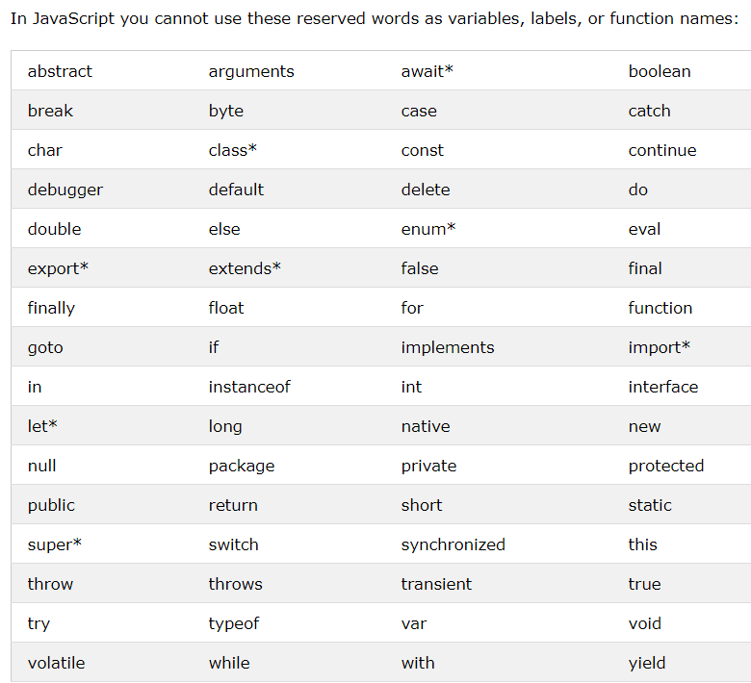
Reserved Words

Slide 54
Functions

Slide 55
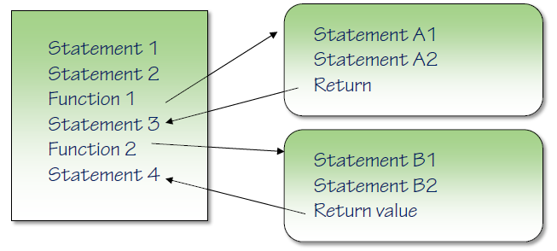
Functions
Naming a function
Anonymous Functions
Parameters Too many? Ignored
Too few? Undefined
Return and Returning a value No return value? Undefined
Hoisting

Slide 56
Simple Function that pass in 2 parameters and returns the sum
<!DOCTYPE html>
<html><head><meta http-equiv="Content-Type" content="text/html; charset=UTF-8">
<head>
<meta charset="utf-8">
<meta http-equiv="X-UA-Compatible" content="IE=edge">
<title>Function</title>
</head>
<body>
<h1>Sum</h1>
<h2 id="demo"></h2>
<!-- <script src="tech1.js" type="text/JavaScript"></script> -->
<script>
var sum = add(5,6);
function add(x, y)
{
var z = x + y;
return z;
}
document.getElementById("demo").innerHTML = sum;
</script>
</body>
</html>

Slide 57
Functions
Program Flow

Slide 58
2.1
<!DOCTYPE html>
<html>
<body>
<p>Hello World:</p>
<p id="demo"></p>
<script>
function hw() {
alert("Hello World");
return;
}
hw();
</script>
</body>
</html>
<!DOCTYPE html>
<html>
<body>
<p>This example calls a function which performs a calculation, and returns the result:</p>
<p id="demo"></p>
<script>
function myFunction(a, b) {
return a * b;
}
document.getElementById("demo").innerHTML = myFunction(4, 3);
</script>
</body>
</html>

Slide 59
<!DOCTYPE html>
<html lang="en" xmlns="http://www.w3.org/1999/xhtml">
<head>
<meta charset="utf-8" />
<title> Interest Calculator</title>
</head>
<body>
<h1>Sum</h1>
<h2>Add three variables with a function</h2>
<input id="input1" type=”number” /> +
<input id="input2" type=”number” /> +
<input id="input3" type=”number” />
<input type="button" id="answer2" value="Answer2" />
<span id="result"></span>
<script>
//BUTTON EVENT LISTENER when click runs the main function
var e2 = document.getElementById('answer2');
// invoke main function when button 2 is clicked
e2.addEventListener('click',main,false);
//MAIN function runs the procedures
function main(){
//CALCULATE – this invokes the function summit, takes in 3 arguments (real values) from user input,
// converts to integer and then returns the total which initialises the value of the global variable sum
var sum = summit(parseInt(input1.value), parseInt(input2.value), parseInt(input3.value));
// alert(sum);
//DISPLAY this function accepts 1 parameter – the argument is the value of the global variable sum and
// displays that value on the webpage
displayit(sum);
}
function summit(x, y, z){
//alert(x + " " + y + " " + z);
total = x + y + z;
return total;
}
function displayit(sum){
//display on webpage
document.getElementById("result").innerHTML = sum;
}
</script>
</body>
</html>
2.2

Slide 60
<!DOCTYPE html>
<html lang="en" xmlns="http://www.w3.org/1999/xhtml">
<head>
<meta charset="utf-8" />
<title>JavaScript local and global variables</title>
</head>
<body>
<h1>JavaScript</h1>
<h2>Local and global variables</h2>
<p>a = 5</p>
<span id="globalvar"></span><br /><br />
<span id="localvar"></span><br /><br />
<script>
//EVENT LISTENER
window.addEventListener('load',localvar,false);
var a = 5; //global variable
document.getElementById("globalvar").innerHTML = "Global variable: " + a;
function localvar() {
var a = 4; //local variable
document.getElementById("localvar").innerHTML = "Local variable: " + a;
}
</script>
</body>
</html>
2.3

Slide 61
<!DOCTYPE html>
<html lang="en" xmlns="http://www.w3.org/1999/xhtml">
<head>
<meta charset="utf-8" />
<title>JavaScript loop from 1 to 50</title>
</head>
<body>
<h1>JavaScript</h1>
<h2>For Loop from 1 to 50</h2>
<input type="button" value="Display 1 to 50" onclick="forloop()" />
<p id="result"></p>
<script>
function forloop() {
var counter = 0;
for (vari = 1; i<= 50; i++){
counter = counter + i + ", ";
}
document.getElementById("result").innerHTML = counter;
}
</script>
</body>
</html>
2.5

Slide 62
<!DOCTYPE html>
<html lang="en" xmlns="http://www.w3.org/1999/xhtml">
<head>
<meta charset="utf-8" />
<title>JavaScript while loop from 1 to 10</title>
</head>
<body>
<h1>JavaScript labs</h1>
<h2>While loop from 1 to 10</h2>
<input type="button" value="Display 1 to 10" onclick=" numberloop()"/>
<span id="result"></span>
<script>
//EVENT LISTENER
window.addEventListener(‘load’,numberloop,false);
function numberloop() {
//test condition first, then execute code within loop
Var i = 1; counter = 0;
while (i<= 10) {
counter = counter + i + ", ";
i++;
}
document.getElementById(“result").innerHTML = counter;
}
</script>
</body>
</html>
2.8

Slide 63
<!DOCTYPE html>
<html lang="en" xmlns="http://www.w3.org/1999/xhtml">
<head>
<meta charset="utf-8" />
<title>JavaScript do...while loop from 1 to 10</title>
<script>
//EVENT LISTENER
window.addEventListener(‘load’,newloop,false);
//do while – executes the loop once then tests the condition
function newloop() {
Var i = 1;
var counter = 0;
do{
counter = counter + i + ", ";
i++
}while(i<= 10);
document.getElementById("theresult").innerHTML = counter;
}
</script>
</head>
<body>
<h1>JavaScript labs</h1>
<h2>Do...While loop from 1 to 10</h2>
<input type="button" value="Display 1 to 10" onclick="lab67()"/>
<span id=“theresult"></span>
</body>
</html>
2.9

Slide 64
<!DOCTYPE html>
<html lang="en" xmlns="http://www.w3.org/1999/xhtml">
<head>
<meta charset="utf-8" />
<title>JavaScript nested loop</title>
<script>
function lab30() {
var i = 0;
var j = 1;
var counter = 0;
var counter2 = 0;
for(;i<= 10; i++){
for (; j <= 10; j++){
//runs nested loop first
counter = counter + j + ", ";
alert("j=" + j + " i=" + i + " counter=" + counter); //test variable values when running code
}
}
}
</script>
</head>
Nested Loop
2.10
<body>
<h1>JavaScript labs</h1>
<h2>Lab 30 - Nested loop</h2>
<input type="button" value="Display 1 to 10" onclick="lab30()" />
<p id="lab30result"></p>
</body>
</html>

Slide 65
Strings

Slide 66
<!DOCTYPE html>
<html>
<!-- this is the strings exercise - 7.1 -->
<head>
<link rel="stylesheet" href="stylesStrings.css">
</head>
<body>
<div>
<h2>Strings - exercise 1 - convert to upper and lower case</h2>
<span>Please enter some text:</span>
<input type = "text" id="inputTextBox"/>
<br/>
<br/>
<button type="button" id="submitText">Submit Text </button>
<br/>
<p>Here is the text that you entered:
<span id="textEntered" class = "outputBox"></span>
</p>
<p>Here it is in upper case:
<span id="textUpperCase" class = "outputBox"></span>
</p>
<p>Here it is in lower case:
<span id=textLowerCase class = "outputBox"></span>
</p>
<br/>
<br/>
</div>
Input String into Upper and Lower Case
<script>
//objects - strings exercise 1 - convert to upper and lower case
//set up an event on the Submit Quiz button
eventSubmit = document.getElementById("submitText");
eventSubmit.addEventListener('click', convertText, false);
function convertText()
{
var textInput = document.getElementById("inputTextBox").value;
document.getElementById("textEntered").innerHTML = textInput;
document.getElementById("textUpperCase").innerHTML = textInput.toUpperCase();
document.getElementById("textLowerCase").innerHTML = textInput.toLowerCase();
}
</script>
</body>
</html>

Slide 67
Arrays

Slide 68
An array is a special variable, which can hold more than one value at a time.
<!DOCTYPE html>
<html>
<body>
<h2>JavaScript Arrays</h2>
<p>The best way to loop through an array is using a standard for loop:</p>
<p id="demo"></p>
<script>
var fruits, text, fruitLength, i;
fruits = ["Banana", 1, "Apple", "Mango"];
fruitLength = fruits.length;
text = "<ul>";
for (i = 0; i < fruitLength; i++) {
text += "<li>" + fruits[i] + "</li>";
}
text += "</ul>";
document.getElementById("demo").innerHTML = text;
</script>
</body>
</html>
Arrays in JavaScript have variable length
All elements in an array can have different data types
First element is: arrayElement[0]
5th element in an array is: arrayElement[4]
Array
Index
For Loop

Slide 69
The Array object enables you to do things to the items in the array
Methods
The join() method of the Array object
The reverse() method of the Array object
The sort() method of the Array object
The pop() method removes the last element from an array
The push() method adds a new element to an array (at the end)
The shift() method removes the first array element and "shifts" all other elements to a lower index.
The unshift() method adds a new element to an array (at the beginning), and "unshifts" older elements:
The splice() method can be used to add new items to an array in a specific position
The concat() method creates a new array by merging (concatenating) existing arrays:
The toString() method converts an array to a comma separated string when a primitive value is expected
Properties
The Array object length property

Slide 70
Displaying elements in Array in lists
For sorting and displaying the above array, use the following code
fruits.sort();
var text2 = "<ul>";
for (var j = 0; j < fruitLength; j++) {
text2 += "<li>" + fruits[j] + "</li>";
}
text2 += "</ul>";
document.getElementById("demo2").innerHTML = text2;
console.log(text2);

Slide 71
Array
Exercises

Slide 72
<!DOCTYPE html>
<html lang="en" xmlns="http://www.w3.org/1999/xhtml">
<head>
<meta charset="utf-8" />
<title>JavaScript allocate to array</title>
</head>
<body>
<h1>JavaScript - Arrays</h1>
<h2>Input, Create an array and display</h2>
<input id="input1"/>
<input id="input2"/>
<input id="input3"/>
<input type="button" value="Create array" onclick="myarray(input1.value, input2.value, input3.value)"/>
<p id="arrayresult"></p><br>
<p id="arrayresult1"></p><br>
<p id="arrayresult2"></p>
<script>
function myarray(x, y, z) {
//declare and create array
Var myArray = [];
myArray[0] = x;
myArray[1] = y;
myArray[2] = z;
//display array on webpage with 2 different approaches
document.getElementById("arrayresult").innerHTML = myArray;
document.getElementById("arrayresult1").innerHTML = myArray.join(", ");
//display item in array with index 1
document.getElementById("arrayresult2").innerHTML = myArray[1];
}
</script>
</body>
</html>
17
Join() Array

Slide 73
<!DOCTYPE html>
<html lang="en" xmlns="http://www.w3.org/1999/xhtml">
<head>
<meta charset="utf-8" />
<title>JavaScript - Array Length</title>
</head>
<body>
<h1>JavaScript - Arrays</h1>
<h2>Array Length</h2>
<input id="input1" />
<input type="button" value="Push value to array" onclick="addtoarray(input1.value)" />
<p id="result"></p>
<p id="lengthcounter"></p>
<script>
Var myArray = [];
function addtoarray(x) {
myArray.push(x);
document.getElementById("result").innerHTML = myArray.join(", ");
document.getElementById("lengthcounter").innerHTML = "Number of elements: " + myArray.length; }
</script>
</body>
</html>

Slide 74
<script>
// ADD EVENT LISTENERS
// var but1 = document.getElementById('myBtn1');
var but1 = document.querySelector("#myBtn1");
but1.addEventListener('click', looparray,false);
//var but2 = document.querySelector("#mybee")
var but2 = document.getElementById('mybee');
but2.addEventListener('click', three,false);
// CREATE ARRAY
var myCountryArray = ["England", "France", "Italy", "Mexico", "Poland", "Russia", "China", "Greece", "Egypt", “Dubai"];
// alert(myCountryArray);
//loop array and display on webpage
function looparray () {
for(var i = 0; i<myCountryArray.length; i++){
document.getElementById("myarray").innerHTML += myCountryArray[i] + " , ";
}
};
//LOOP - get user input, then search array for a match
function three () {
var x = document.getElementById("guess").value;
alert(x);
for(var j = 0; j <myCountryArray.length; j++){
if (x == myCountryArray[j]) {
document.getElementById("myarray3").innerHTML = " Success!";
// alert(myCountryArray[j]);
document.getElementById("myarray4").innerHTML = "Value: " + myCountryArray[j];
// alert(j);
document.getElementById("myarray5").innerHTML = "Position: " + j;
return true;
}
else {
document.getElementById("myarray3").innerHTML = " Failure";
}
}
};
</script>
<!DOCTYPE html>
<head>
<meta charset="utf-8" />
<title>JavaScript add and display 10 members of an array</title>
</head>
<body>
<h1>JavaScript</h1>
<h2>Display 10 members of an array using for loop</h2>
<!-- <button type="button" id="myBtn1" onclick="looparray()">Display member from country array</button> -->
<button type="button" id="myBtn1">Display member from country array</button>
<input type="text" id="guess" />
<button type="button" id="mybee">Search</button>
<p id="myarray"></p>
<p id="myarray3"></p>
<p id="myarray4"></p>
<p id="myarray5"></p>
</body>
</html>

Slide 75
Mini Projects

Slide 76
Requirements
Design
Functional
UI
Data
Components
Logic Structure
Readability
Reusability
Maintainability
Non Functional
Performance
Testing Strategy
Development
Testing
Deployment

Slide 77
Vending Machine Change (Core version)
User enters money number value between £1-£100 to 2 decimal places
The correct and lowest number of money denominations are listed to represent the amount
Following denominations accepted: 5,10, 20, 50 cents £1, £2, £5, £10, £20, £50
Test case 1
Input £47.50
Output
2 x £20
1 x £5
1 X £2
1 x 50 cents
Test case 2
Input £105
Output
Invalid amount
Amount must be between £1-£100
Test case 3
Input £91
Output
1 X £50
2 X £20
1 X £1

Slide 78
END

Slide 79
Regular Expressions
https://regex101.com/, to check meaning of Regex

Slide 80
<!DOCTYPE html>
<html>
<body>
<p>Search a string for "w3Schools", and display the position of the match:</p>
<button onclick="myFunction()">Try it</button>
<p id="demo"></p>
<script>
function myFunction() {
var str = "JavaScript is fun";
var n = str.search(/fun/i);
document.getElementById("demo").innerHTML = n;
}
</script>
</body>
</html>
A regular expression is a sequence of characters that forms a search pattern.
The search pattern can be used for text search and text replace operations.
Syntax
/pattern/modifiers;
var patt = /fun/i;
i is a modifier (modifies the search to be case-insensitive).
The search() method uses an expression to search for a match, and returns the position of the match.
The replace() method returns a modified string where the pattern is replaced.

Slide 81
var num = 5.56789;
var n = num.toFixed(2);
console.log("n = " + n);
Math.random(
<script>
Convert string to number
function myFunction() {
var a = parseInt("10") + "<br>";
var b = parseInt("10.00") + "<br>";
var c = parseInt("10.33") + "<br>";
var d = parseInt("34 45 66") + "<br>";
var e = parseInt(" 60 ") + "<br>";
var f = parseInt("40 years") + "<br>";
var g = parseInt("He was 40") + "<br>";
var h = parseInt("10", 10)+ "<br>";
var i = parseInt("010")+ "<br>";
var j = parseInt("10", 8)+ "<br>";
var k = parseInt("0x10")+ "<br>";
var l = parseInt("10", 16)+ "<br>";
var n = a + b + c + d + e + f + g + "<br>" + h + i + j + k +l;
document.getElementById("demo").innerHTML = n;
}
</script>
//Regular expression to check if input is a number
var str = document.getElementById("input1").value;
var reg = /^\d+$/;
console.log(str.search(reg));

Slide 82
Output JavaScript
There are 4 ways to output JavaScript:
Writing into an HTML element, using innerHTML.
Writing into the HTML output using document.write().
Writing into an alert box, using window.alert().
Writing into the browser console, using console.log()
<!DOCTYPE html>
<html>
<body>
<h2>JavaScript</h2>
<p>Output JavaScript</p>
<p id="demo"></p>
<script>
document.write(5 + 6);
window.alert(5 + 6);
console.log(5 + 6);
document.getElementById("demo").innerHTML = 5 + 6;
</script>
</body>
</html>

Slide 83
Invoking JavaScript
In HTML Block
In HTML, JavaScript code must be inserted between <script> and </script> tags.
JavaScript function is placed in the <body> section of an HTML page.
The function is invoked (called) when a button is clicked:
<!DOCTYPE html>
<html>
<body onload=age()>
<p id="demo"></p>
<script> document.getElementById("demo").innerHTML = "My First JavaScript"; </script>
</body>
</html>

Slide 84
Event Listeners
Event Listeners are the modern approach to invoking JavaScript on HTML events.
Event listeners support the development of separated code and decoupling from the HTML document.
<!DOCTYPE html>
<html>
<head></head>
<body>
<form>
<input type="text" id="input1"/></form>
<div><button id="button1">Button</button> </div>
<div id="demo"></div>
<script>
//EVENT LISTENER
var event1 = document.getElementById("button1");
event1.addEventListener('click',writeinput,false);
function writeinput(){
//User input 1
var userinput1 = document.getElementById("input1").value;
//Output 1
document.getElementById("demo").innerHTML = userinput1;
}
</script>
</body>
</html>
HTML
X
JavaScript
JavaScript
HTML

Slide 85
Scope
Scope determines the accessibility of variables, objects, and functions from different parts of the code.
<!DOCTYPE html>
<html>
<body>
<p>The local variable carName cannot be accessed from code outside the function:</p>
<p id="demo"></p>
<script>
myFunction(carName);
document.getElementById("demo").innerHTML =
"The type of carName is " + typeof (carName);
function myFunction() {
var carName = "Volvo";
}
</script>
</body>
</html>
The lifetime of a JavaScript variable starts when it is declared.
Local variables are deleted when the function is completed.

Slide 86
The window Object
<!DOCTYPE html>
<html>
<body>
<div id="result2"></div>
<div id="result"></div>
<script>
// Check browser support
if (typeof(Storage) !== "undefined") {
// Store
localStorage.setItem("lastname", "Smith");
// Retrieve
document.getElementById("result").innerHTML = localStorage.getItem("lastname");
} else {
document.getElementById("result").innerHTML = "Sorry, your browser does not support Web Storage...";
}
</script>
<script>
//comment out session storage and reopen in new browser window to show local storage retains value
// Check browser support
if (typeof(Storage) !== "undefined") {
// Store
sessionStorage.setItem("lastname2", "Brown");
// Retrieve
document.getElementById("result2").innerHTML = sessionStorage.getItem("lastname2");
} else {
document.getElementById("result2").innerHTML = "Sorry, your browser does not support Web Storage...";
}
</script>
</body>
</html>
The window object represents an open window in a browser. There are many properties and methods to access
The localStorage and sessionStorage properties allow to save key/value pairs in a web browser.
The sessionStorage object stores data for only one session (the data is deleted when the browser tab is closed).
The localStorage and sessionStorage properties allow to save key/value pairs in a web browser.
The localStorage object stores data with no expiration date. The data will not be deleted when the browser is closed, and will be available the next day, week, or year.
The localStorage property is read-only
https://www.w3schools.com/jsref/obj_window.asp

Slide 87
The document Object
<!DOCTYPE html>
<html>
<body>
<div class="example">First div element with class="example".</div>
<div class="example">Second div element with class="example".</div>
<p>Click the button to change the text of the first div element with class="example" (index 0).</p>
<button onclick="myFunction()">Change Text</button>
<script>
function myFunction() {
//returns a node list (array) of all elements in HTML page with class=example
var x = document.getElementsByClassName("example");
//change value of node[0]
x[0].innerHTML = "Hello World!";
}
</script>
</body>
</html>
When an HTML document is loaded into a web browser, it becomes a document object.
Provides the properties and methods to work with the current document
The bgColor and fgColor properties
The title property
The lastModified property
Referencing remote window and document objects

Slide 88
The location Object
Allows you to specify URLs in a script
The image Object
Location Object
The location object contains information about the current URL.
The location object is part of the window object and is accessed through the window.location property.
Note: There is no public standard that applies to the location object, but all major browsers support it.
Allows you to manipulate images in browsers
Handling image object events
JavaScript and image maps
The history Object
Allows the user to move backward or forward through the stored history of your Web page
The navigator Object
Determines the brand and version of the browser in use
Identifies the user's operating system
Redirecting the browser with the navigator and location objects

Slide 89
Validation

Slide 90
Data Validation
Data validation is the process of ensuring that user input is clean, correct, and useful.
Typical validation tasks are:
has the user filled in all required fields?
has the user entered valid data?
has the user entered text in a numeric field?
Most often, the purpose of data validation is to ensure correct user input.
Validation can be defined by many different methods, and deployed in many different ways.
Server side validation is performed by a web server, after input has been sent to the server.
Client side validation is performed by a web browser, before input is sent to a web server.

Slide 91
<!DOCTYPE html>
<html>
<head></head>
<body>
<input type="text" id="input1" />
<div><button id="button1">Button</button> </div>
<div id="demo"></div>
<script>
//EVENT LISTENER
var event1 = document.getElementById("button1");
event1.addEventListener('click', validation, false);
function validation() {
//User input 1
var userinput1 = document.getElementById("input1").value;
if (userinput1 == "") {
alert("You must enter a value");
}
else {
console.log(userinput1);
document.getElementById("demo").innerHTML = userinput1;
// myfirst(userinput1); // you can call a function within a function
}
}
</script>
</body>
</html>
User’s Input Validation
Validation

Slide 92
Debugging
X
<!DOCTYPE html>
<html>
<body>
<h2>My First Web Page</h2>
<p>
Activate debugging in your browser (Chrome, IE, Firefox) with F12, and select "Console" in the debugger menu.
</p>
<script>
a = 5;
b = 6;
c = a + b;
console.log(c);
</script>
</body>
</html>
Errors can (will) happen, every time you write some new computer code.
code might contain syntax errors, or logical errors
F12 key, and select "Console"

Slide 93
Error Handling
Errors can (will) happen, every time you write some new computer code.
code might contain syntax errors, or logical errors
F12 key, and select "Console"
The try statement lets you test a block of code for errors
The catch statement lets you handle the error
The throw statement lets you create custom errors
The finally statement lets you execute code, after try and catch, regardless of the result.

Slide 94
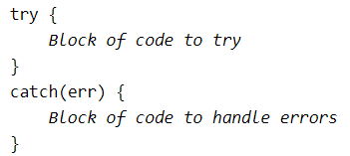
try catch
The try statement allows you to define a block of code to be tested for errors while it is being executed.
The catch statement allows you to define a block of code to be executed, if an error occurs in the try block.
The JavaScript statements try and catch come in pairs:
<!DOCTYPE html>
<html>
<body>
<p id="demo"></p>
<script>
try {
adddlert("Welcome guest!");
}
catch(err) {
document.getElementById("demo").innerHTML = err.message;
}
</script>
</body>
</html>

Slide 95
throw
When an error occurs, JavaScript will normally stop and generate an error message.
The technical term for this is: JavaScript will throw an exception (throw an error).
<!DOCTYPE html>
<html>
<body>
<p>Please input a number between 5 and 10:</p>
<input id="demo" type="text">
<button type="button" onclick="validateFunction()">Test Input</button>
<p id="message"></p>
<script>
function validateFunction() {
var message, x;
message = document.getElementById("message");
message.innerHTML = "";
x = document.getElementById("demo").value;
try {
if(x == "") throw "empty";
if(isNaN(x)) throw "not a number";
x = Number(x);
if(x < 5) throw "too low";
if(x > 10) throw "too high";
}
catch(err) {
message.innerHTML = "Input is " + err;
}
}
</script>
</body>
</html>
The throw statement allows you to create a custom error.
Technically you can throw an exception (throw an error).

Slide 96
HTML Validation
HTML Validation
Modern browsers will often use a combination of JavaScript and built-in HTML validation, using predefined validation rules defined in HTML attributes:
<!DOCTYPE html>
<html>
<body>
<p>Please input a number between 5 and 10:</p>
<input id="demo" type="number" min="5" max="10" step="1">
<button type="button">Test Input</button>
<p id="message"></p>
</body>
</html>

Slide 97

External JavaScript File
<!DOCTYPE html>
<html>
<body>
<h2>External JavaScript</h2>
<p id="demo">A Paragraph.</p>
<button type="button" onclick="myFunction()">Try it</button>
<p>(myFunction is stored in an external file called "myScript.js")</p>
<script src="myScript.js"></script>
</body>
</html>
function myFunction() { document.getElementById("demo").innerHTML = “JavaScript does something."; }

Slide 98
Mini Projects 2.1

Slide 99
Common coding errors
JavaScript programs may generate unexpected results if a programmer accidentally uses an assignment operator (=), instead of a comparison operator (==) in an if statement.
<!DOCTYPE html>
<html>
<body>
<p id="demo"></p>
<p id="demo1"></p>
<script>
var x = 0;
document.getElementById("demo").innerHTML = Boolean(x = 10);
document.getElementById("demo1").innerHTML = Boolean(x == 10);
</script>
</body>
</html>

Slide 100
JavaScript programs may generate unexpected results if a programmer accidentally uses regular comparison == and not strict ===.
Use strict only === when comparing to minimise errors
<!DOCTYPE html>
<html>
<body>
<p id="demo"></p>
<p id="demo1"></p>
<script>
var w = 10 + "5";
document.getElementById("demo1").innerHTML = w + " " + typeof(w);
var x = 10;
var y = "5";
var z = x + y;
document.getElementById("demo").innerHTML = z + " " + typeof(z);
</script>
</body>
</html>

Slide 101
In a web browser, global variables are deleted when you close the browser window (or tab), but remain available to new pages loaded into the same window.
<!DOCTYPE html>
<html>
<body>
<p>
Global variables will become window variables.
</p>
<p id="demo"></p>
<script>
var carName = "Volvo";
// code here can use window.carName
document.getElementById("demo").innerHTML = "I can display " + window.carName;
</script>
</body>
</html>
Always use local variables where you can.

Slide 102
Algorithms

Slide 103
Algorithms
Algorithms
Flowcharts
Decision tables
Sorting algorithms
An algorithm is a set of ordered and finite steps to solve a given problem

Slide 104
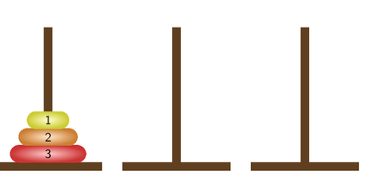
Recursion
Where a function or method calls itself
It MUST have a stop condition
Called the base condition
Mainly mathematical uses

Slide 105

Flowcharts
A flowchart is a graphical representation of an algorithm
Common Flowchart Symbols
 | Start or end of an algorithm
 | Process or computational operation
 | Input or output operation
 | Decision making operation
 | Direction of the flow of control

Slide 106
Flowcharts - example
A flowchart that compares two numbers
Start
Input x
Input y
x > y?
No
Output y
Yes
Output x
Stop

Slide 107
Sorting algorithms
Quick sort
Probably the fastest sorting algorithm
Uses divide and conquer idea – list is subdivided into halves, quarters, etc., until sorts are easily done
Example
 |  | 5,1,3,2,4 |  |  | Choose a pivot element, e.g. 3, and divide the list into 3
 | 2,1 | 3 | 5,4 |  | Move everything less than 3 to the left list and everything greater than 3 to the right list
1 | 2 | 3 | 4 | 5 | Choose a pivot element in the left and right lists and move everything less than the pivot to the left and everything greater to the right. The lists now consist of single elements, which are sorted.
 |  | 1,2,3,4,5 |  |  | Put the lists back together to form a sorted list

Slide 108
Useful links
https://developer.mozilla.org/en-US/docs/Web/Events
https://stackoverflow.com/questions/12045440/difference-between-document-addeventlistener-and-window-addeventlistener
https://www.w3schools.com/js/js_number_methods.asp
https://www.w3schools.com/js/js_regexp.asp
Animation
https://commons.wikimedia.org/wiki/File:Quicksort-example.gif
RegExp: https://regexr.com
Quicksort vs. bubblesort
https://www.youtube.com/watch?v=vxENKlcs2Tw

